Slide 1
Lebanon Vehicle sharing initiative

Slide 2
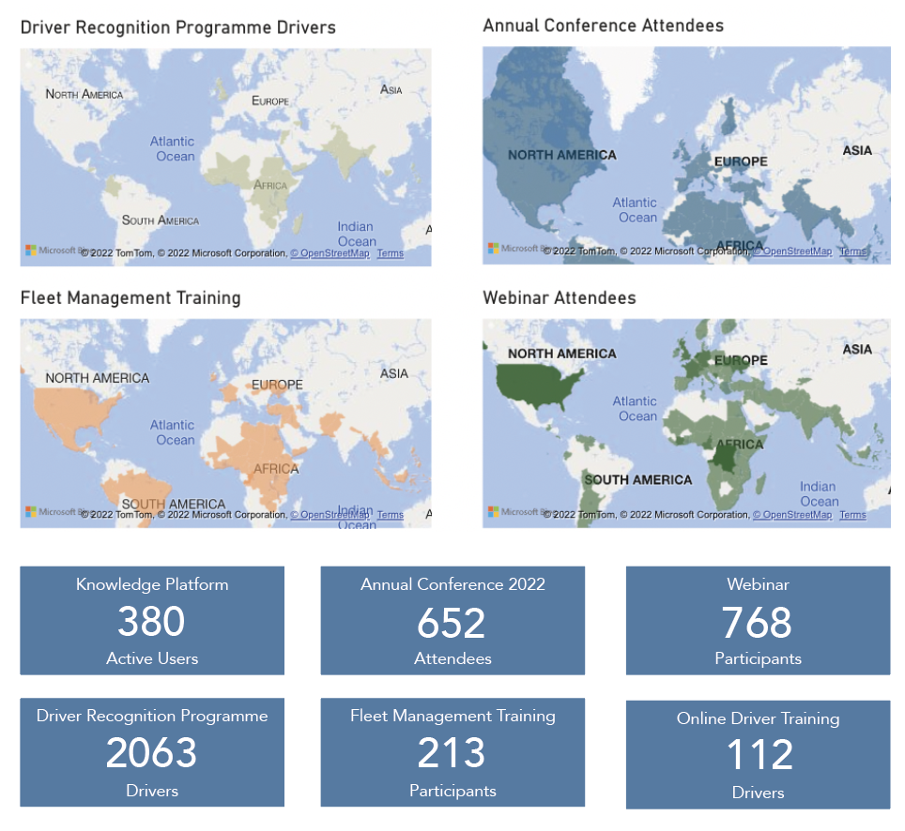
What is Fleet Forum?
Innovative Strategies for the Road Ahead
Swiss, not-for-profit membership association
Inspiring better, cleaner, safer and more effective transport around the world
We are enablers
We bring together key players in the aid and development and commercial transport sectors.
We facilitate knowledge and experience sharing
We develop programmes to realise better fleet management
In 2022, we worked together with Fleet Managers and Drivers around the world:

Slide 3
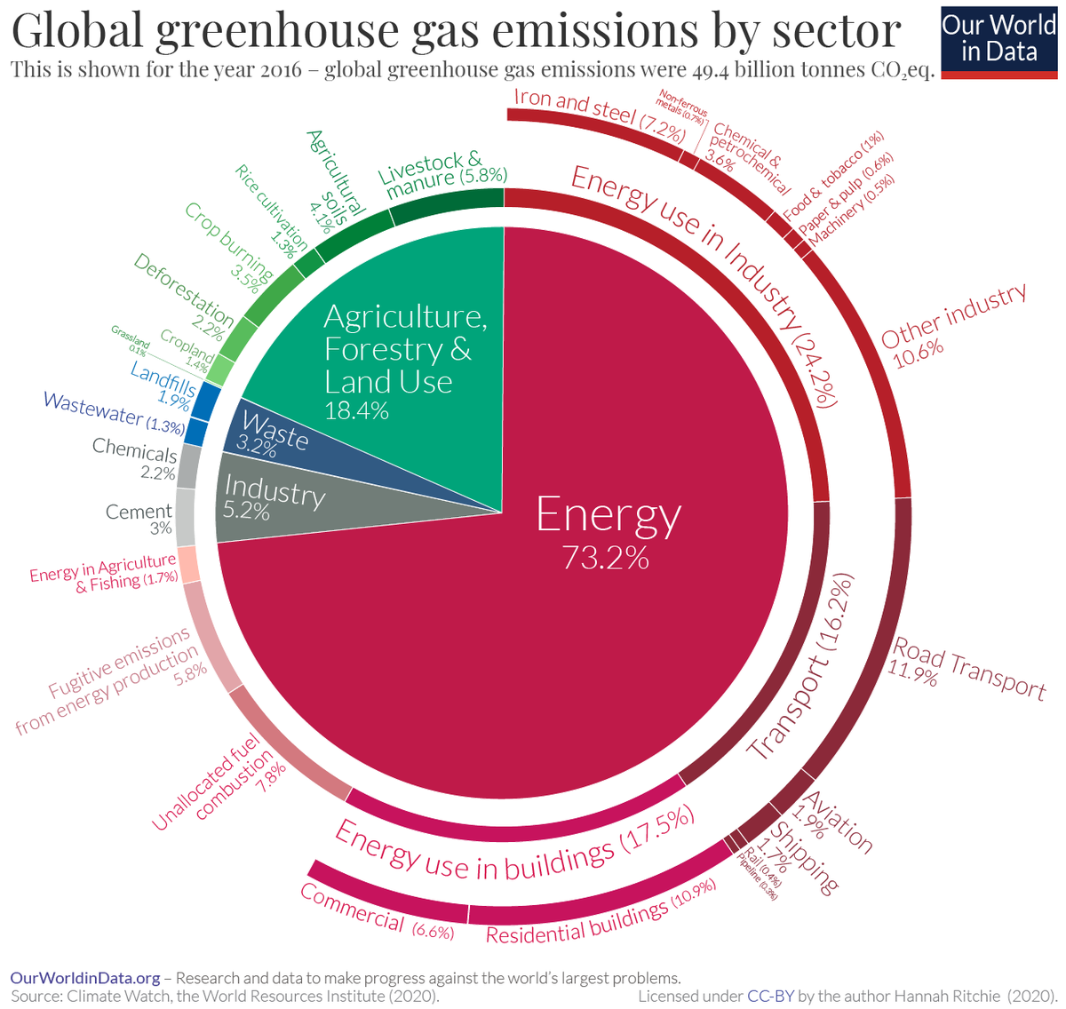
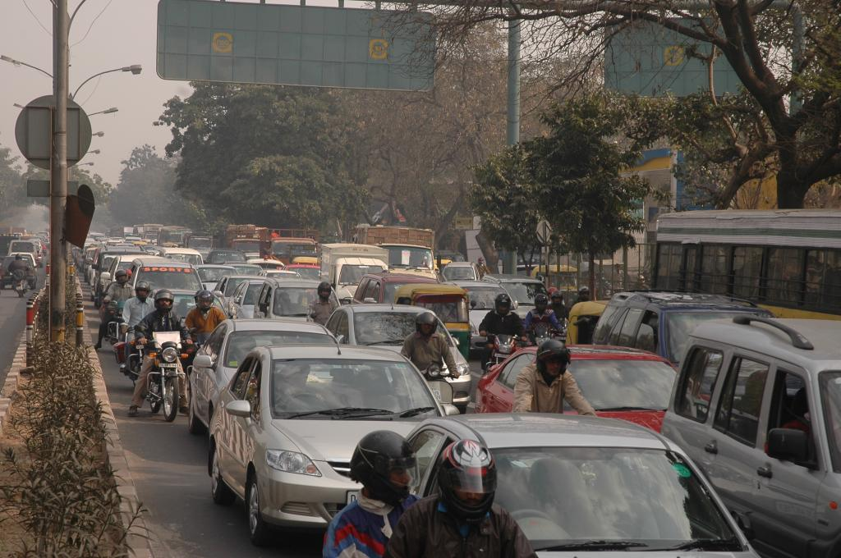
Background - Facts and Figures (1)
1,2 billions vehicles on the planet
(Credit: Samrat Mukherjee/CSE)
Notes:
-1,2 billions vehicles on the planet, expectation it double by the end of the century
-transport contributes up to 16,2% of global GHG, road transport alone 11,9%
-transport therefore a massive leverage of action

Slide 4
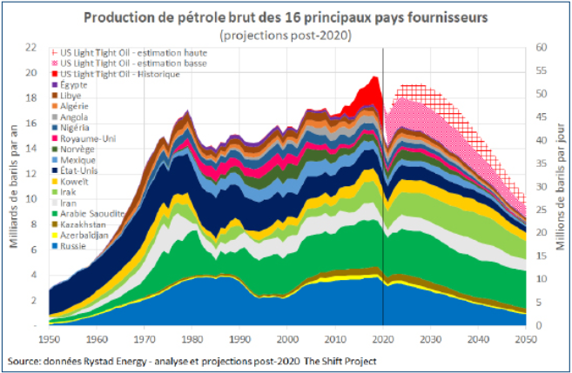
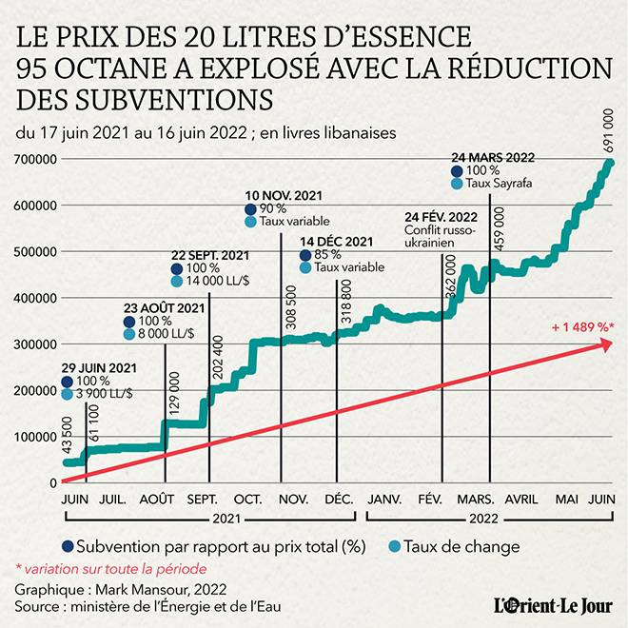
Background - Facts and Figures (2)
BUSINESS AS USUAL = WORST CASE SCENARIO
Notes:
-Peak oil is passed: production projection are decreasing
-That will imply reduction of availability and increase of Price
-the lebanese example is not linked to the above (mainly removal of subsidies) but still gives a trends of what can be expected (increase of 1489% in 1 year)

Slide 5
Fleet Management: Levers of Action?
1 - REDUCE DEMAND
2 - OPTIMIZE WHAT IS NOT REDUCED
Reduce movements (sufficiency)
Reduce size of fleets (sufficiency)
Reduce size and power of vehicles (sufficiency)
Increase occupancy rate of vehicles (sufficiency)
Implement eco-driving good practices (sufficiency)
Promote public transport and soft mobility (sufficiency)
Ensure proper preventive maintenance
Source fuel efficient vehicles? (technology)
Source efficient fuels? (technology)
Electric vehicles? (technology)

Slide 6
Add Your Agency Name: Environmental Commitments
Each organization to add display and explain here its global environmental engagements…
And highlight the fact that the vehicle sharing initiative is an opportunity to walk the talk

Slide 7
Lebanon Vehicle sharing initiative

Slide 8
Lebanon Project Background
What is the problem?
- Cost of fleet operations / fuel
- Co2 eq. emissions
What is the opportunity?
- Concurrency of routes/journeys used by NGOs
- Costs reduction = Co2 eq. Emissions reduction
- Walking the talk of environmental footprint reduction commitments
Lebanon Vehicle Sharing

Slide 9
Lebanon Project Objectives
Costs reduction
Environmental footprint reduction
Develop a proof of concept
Lebanon’s reduced traffic, pollution
Coherence, exemplarity, lead by example
Lebanon Vehicle Sharing

Slide 10
Way Forward
Stage 1 – ‘Shuttle routes’
BEY-Zahle / BEY-Tripoli / BEY-Sour
1 - Fixed departure points, time
2 - Agencies travelling on the route acknowledge available seats (MS teams)
3 - Other agencies can allocate passengers to the available seats
Lebanon Vehicle Sharing

Slide 11
Security, Safety
Minimum requirements are set:
- insurance and vehicles technical fitness (preventive maintenance…)
- drivers recruitment and training
- lead and responsibility of leading agency (providing vehicle) to
> clear movements
> follow-up movements
> implement protocols in case of accident/incident
>inform immediatly and incident report to participating agencies in case
Lebanon Vehicle Sharing

Slide 12
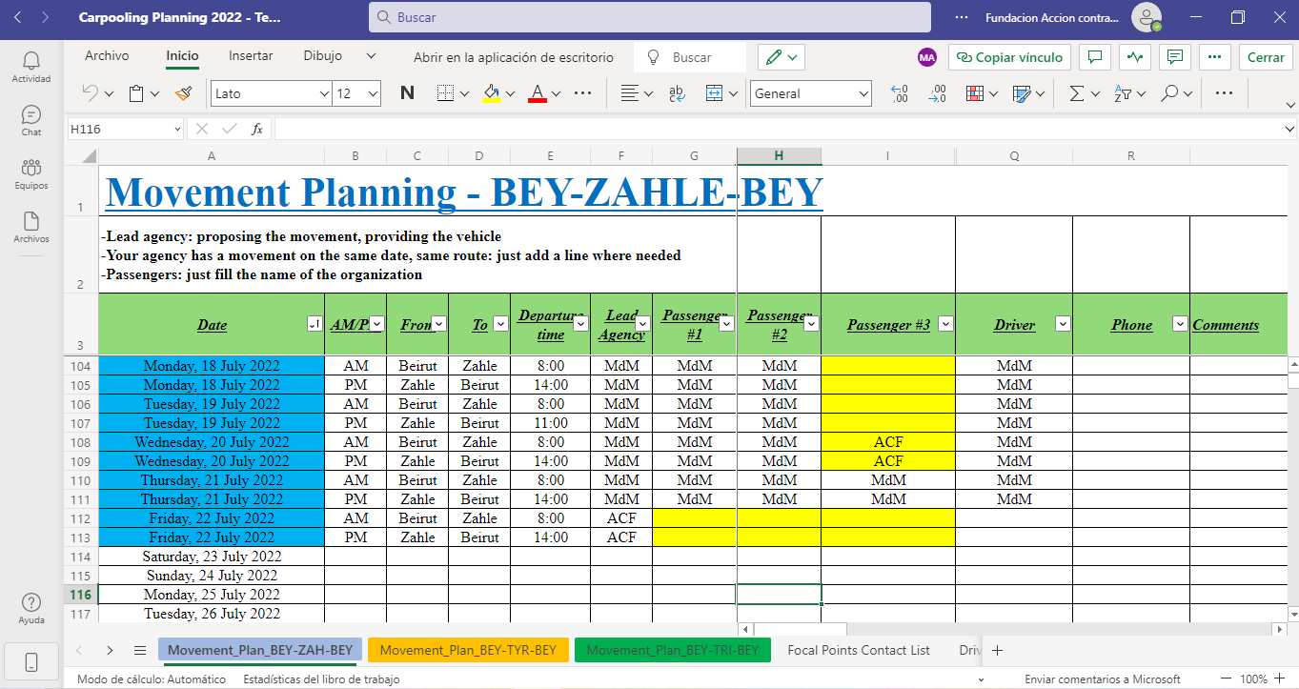
Booking
Organization’s put in common their respective movements plan every Friday
Common file (Ms Teams)
Concuring trips are identified
Fleet managers can allocate their passengers accordingly to other agencies
NB: no change of booking practices for passengers
Sample of current booking solution (for dispatchers/fleet managers only)
Lebanon Vehicle Sharing

Slide 13
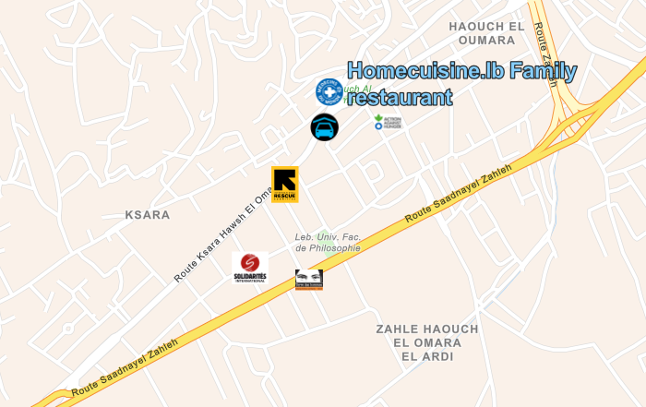
Meeting Points
Mapping of partner agencies offices
In order to identify best meeting points
Considering following criterias when possible:
- Walking distance from offices
- Access safety
- Parking availability
New/additional meetings points will be agreed upon based on joining organizations locations
Meeting point
Ex: Zahle offices localisations
Lebanon Vehicle Sharing

Slide 14
What does it involve for Users / Passengers?
Movement planning: unchanged (weekly, deadline Thursday)
Quality of service: unchanged (safety, timely, reliability)
Visibility/ ID: unchanged (Ngo ID cards, low visibility profile)
Covid rules: unchanged (harmonized)
Type of vehicles: changing based on needs and leading agency
Passengers: can be from different organizations
Departure/arrival points: fixed
Departure times: fixed
Change management
Only ‘effort’ for passengers
Contributes to optimization (heading to Zahle for a 1h meeting ?!)

Slide 15
Suggestions, Feedback, Complaints
Feedback is necessary, please provide them as usual to your <fleet manager> and/or <logistician>
Complaint mechanism: remain unchanged (add here >organization< rules)

Slide 16
Reach out
Agencies to add here their respective focal points contacts
You can also reach out anytime to:
Cyril Pierrot Project Coordinator | Fleet Forum
M: +961 76 922 878 E: cyril.pierrot@fleetforum.org

Slide 17
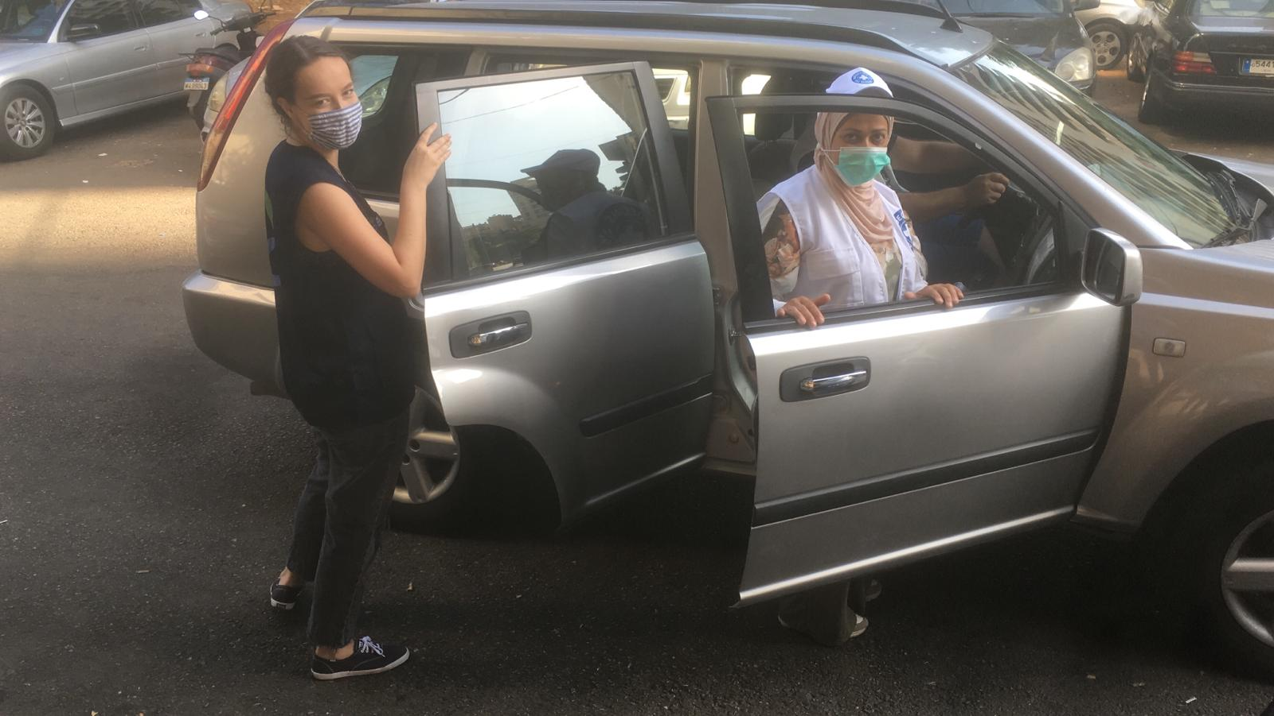
Come join us and let’s explore together !

